Slide 1
3D Model of Dharahara
Anish Sah (PUL074BEX005) Pradipta Pradhanang (PUL074BEX022) Pratik Sharma (PUL074BEX029) Sukirti Bhattarai (PUL074BEX045)

Slide 2
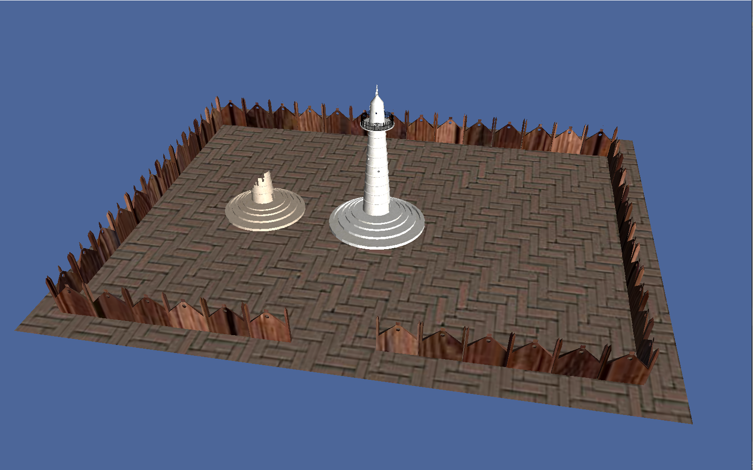
Final Model

Slide 3
Flowchart:
Start
Create Main Window
Load Object File
Load Texture File
Render Object
NO
If Key= ‘Esc’?
YES
Start

Slide 4
Packages used
Glfw( Graphics Library Framework)//mainly used for window Rendering,I/O operation.
Pyrr(3-D mathematical function)
Numpy(used for multi-dimensional array and matrix data structures)
pillow(PIL FORK)(used for loading image)

Slide 5
Files:
ObjLoader
TextureLoader
Camera
Shader files

Slide 6
Features through coding
3D Model of New Dharahara along with the old one.
360 degree view of Darahara.
Effect of directional light and shading.
A very user friendly control of the viewing angle

Slide 7
Methodology
Initialization of GLFW library
Window object is created
.obj file is used to store the vertices,texture coordinates,normals and triangulated faces in a list
A VAO is created and binded
A VBO is created and binded
Attriburepointer were allocated for each vertices,texture coordinates,normals
Png file is read for the texture.

Slide 8
Methodology cntd…
Shader file is used for required position calculation which are then stored in related matrices with required transformation
We use a main window loop which runs until the viewing window is closed.
Input is checked if any from keyboard or mouse for the change in camera position.
Object is shown in the window with shading.

Slide 9
Why python?

Slide 10
Used concept
3-D transformation(3-D to 2-D)
Perspective projection
Changing world coordinates to view coordinates
Object loading in a 3-D space
Directional lighting effect with shading

